Slide 1
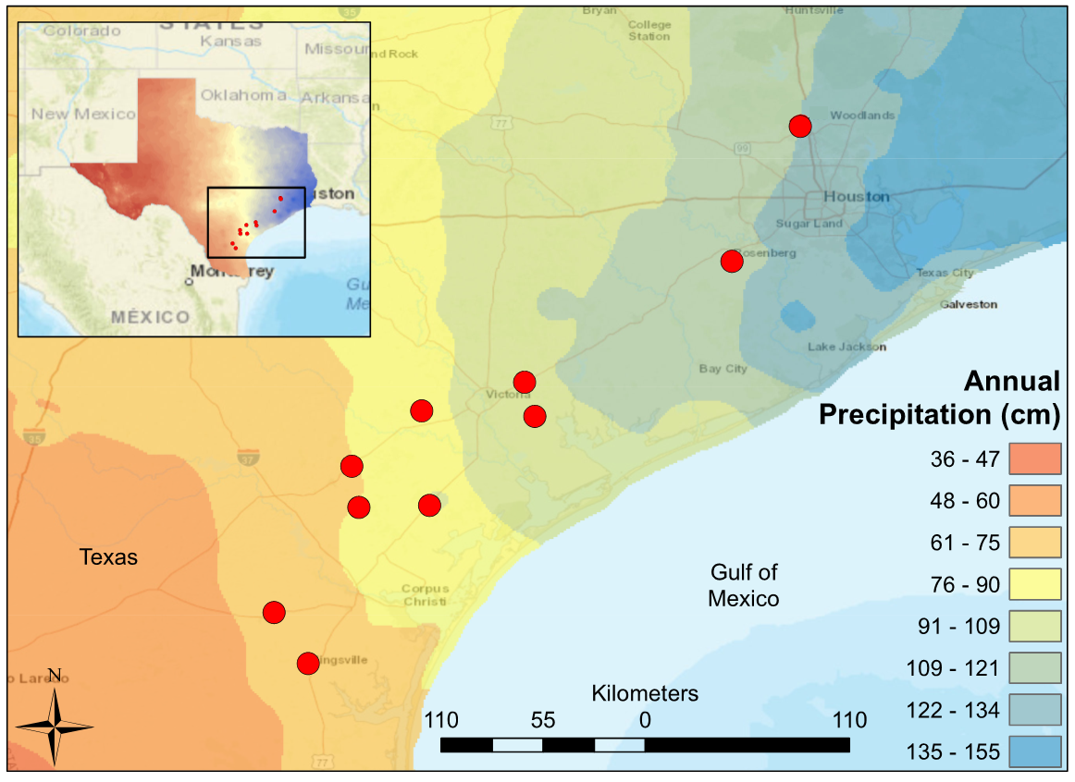
Notes:
Figure 1: Map of South Central Texas, where 10 USGS gaged Streams were sampled in the Spring of 2017. An annual precipitation overlay indicate that the sample sites span a gradient from 61 cm/yr in the Southwest to 134 cm/yr in the Northeast.

Slide 2
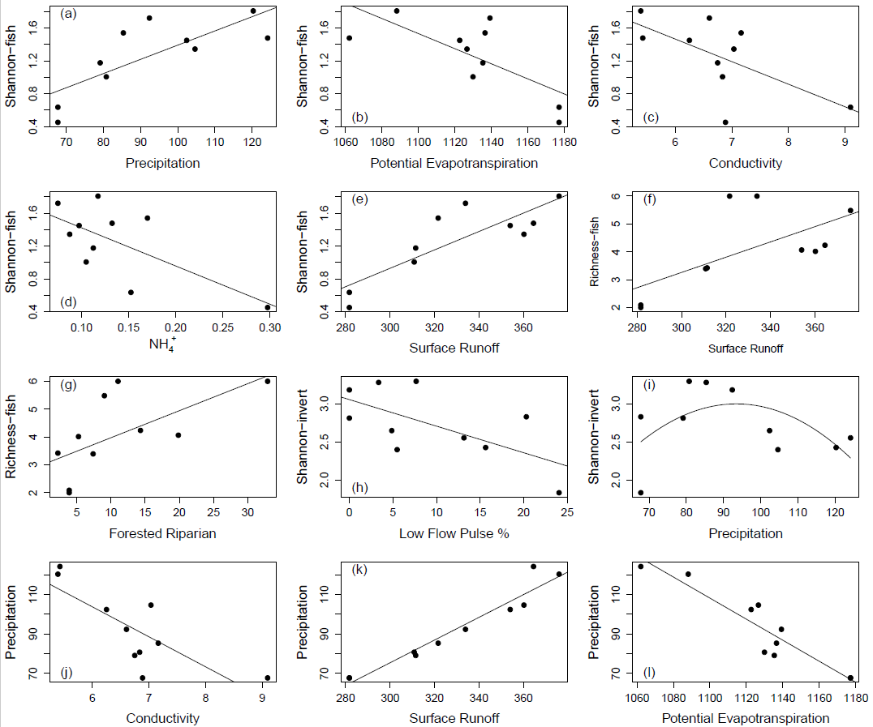
Notes:
Figure 2: Strongest relationships between environmental variables and (a-e) Fish Shannon Index, (f-g) Fish Rarified Richness, (h-i) Invertebrate Shannon Index, (j-l) Annual Precipitation. Fish diversity increases with increasing precipitation and Forested Riparian. Fish diversity decreases as NH4+ increases. Invertebrate diversity correlates negatively with Low Flow (LFPP), and a second order polynomial indicates a potential maximum in the climate transition-zone. Conductivity, Surface Runoff, and Potential Evapotranspiration covary with precipitation and fish diversity.

Slide 3
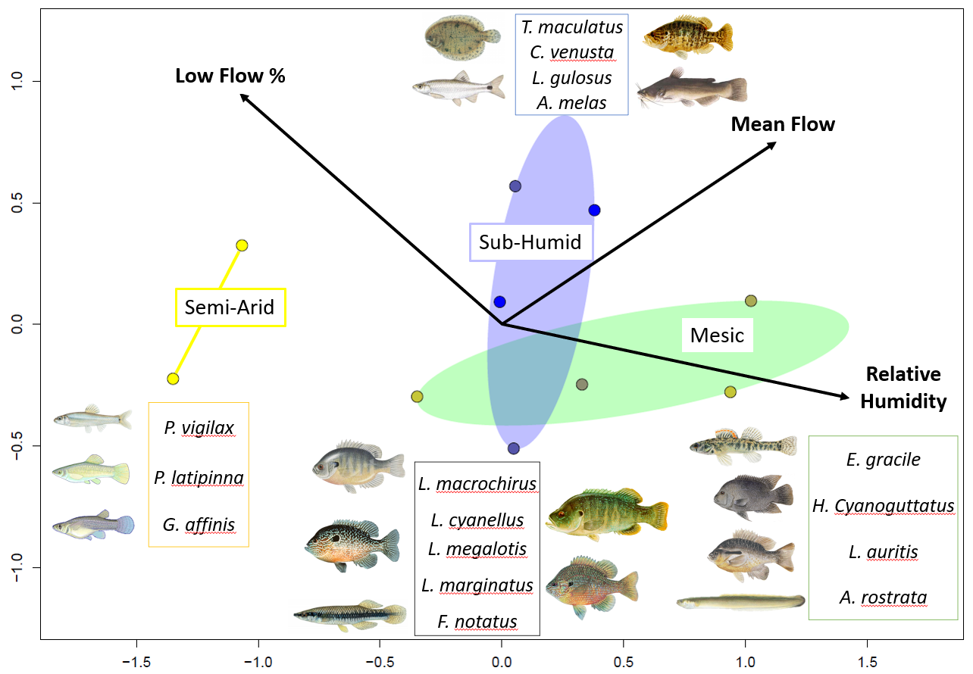
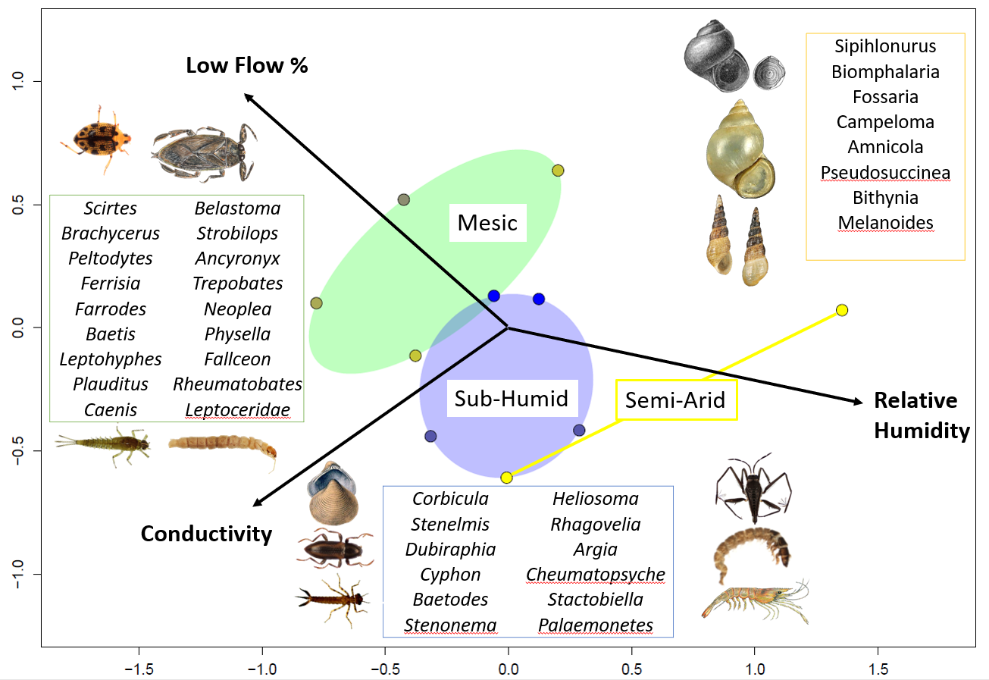
a)
NMDS 2
b)
NMDS 2
NMDS 1
Notes:
Figure 3: NMDS of (a) fish communities and (b) invertebrate communities. Sites are grouped by precipitation regime; Semi-Arid (yellow), Mesic (green), and Sub-Humid (blue). Arrows indicate the strongest fitted environmental variables (p-value < 0.1) with length and direction corresponding to explanatory power. Semi-arid communities are dominated by livebearers (Poecilidae) and snails (Gastropoda). Mesic and Sub-Humid communities contain a variety of sunfish (Centrarchidae), mayfly (Ephemeroptera), caddisfly (Trichoptera), true-bug (Hemiptera), and beetle (Coleoptera) taxa. Sub-Humid communities contain different species of mayfly, caddisfly, true-bug, and beetle, but uniquely contain contain catfish (Ictaluridae), shrimp (Crustacea) and dragonfly (Odonata) taxa. Relative Humidity and Low Flow Pulse Percent correlates strongly with variation along the NMDS1, on which community grouping separate.

Slide 4
a)
b)
NMDS 2
NMDS 2
NMDS 1
NMDS 1
Notes:
Figure 3: NMDS of (a) fish communities and (b) invertebrate communities. Sites are grouped by precipitation regime; Semi-Arid (yellow), Mesic (green), and Sub-Humid (blue). Arrows indicate the strongest fitted environmental variables (p-value < 0.1) with length and direction corresponding to explanatory power. Semi-arid communities are dominated by livebearers (Poecilidae) and snails (Gastropoda). Mesic and Sub-Humid communities contain a variety of sunfish (Centrarchidae), mayfly (Ephemeroptera), caddisfly (Trichoptera), true-bug (Hemiptera), and beetle (Coleoptera) taxa. Sub-Humid communities contain different species of mayfly, caddisfly, true-bug, and beetle, but uniquely contain contain catfish (Ictaluridae), shrimp (Crustacea) and dragonfly (Odonata) taxa. Relative Humidity and Low Flow Pulse Percent correlates strongly with variation along the NMDS1, on which community grouping separate.

Slide 5
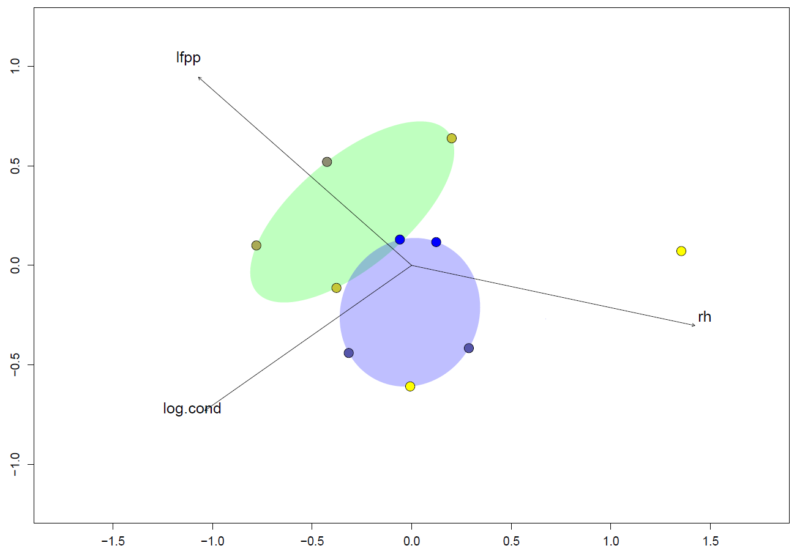
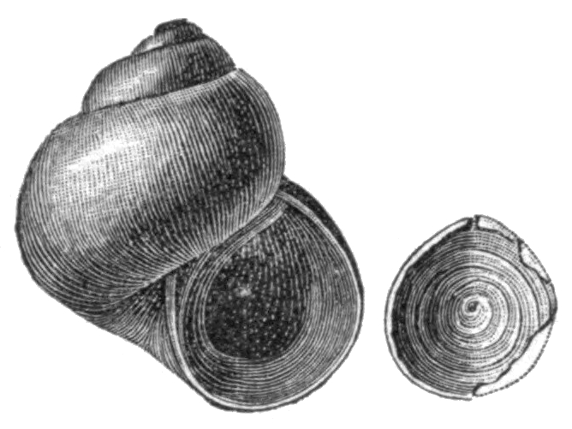
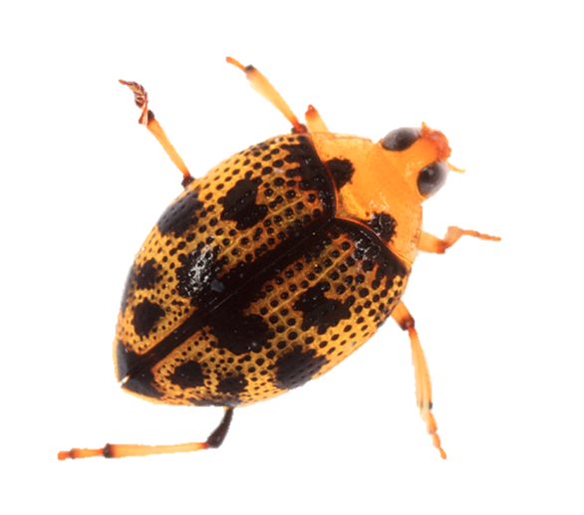
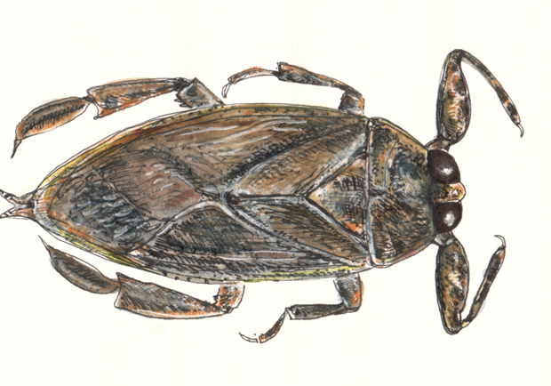
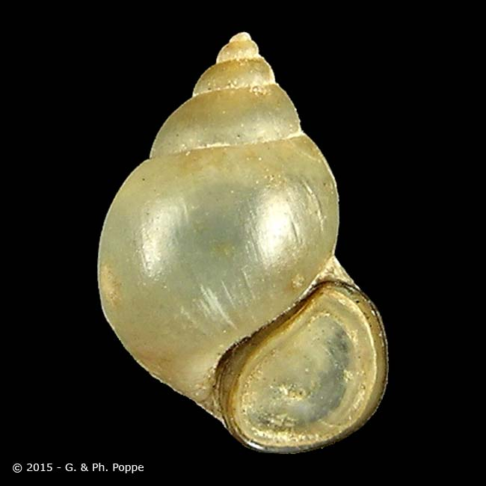
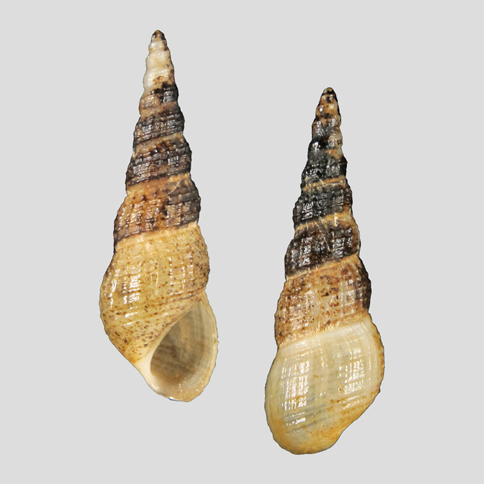
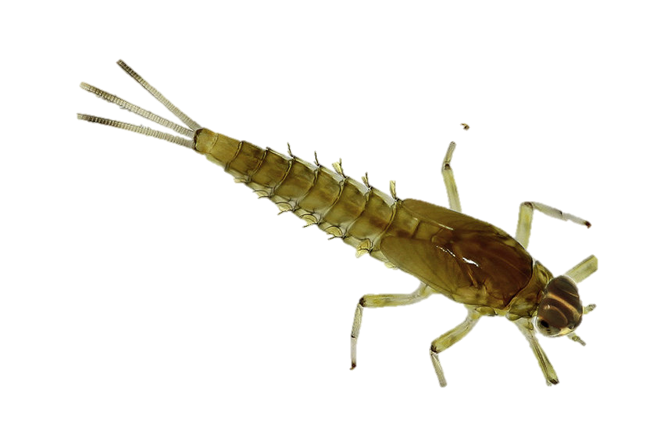
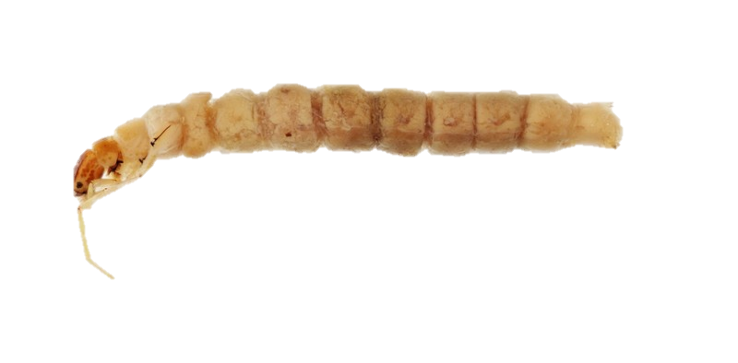
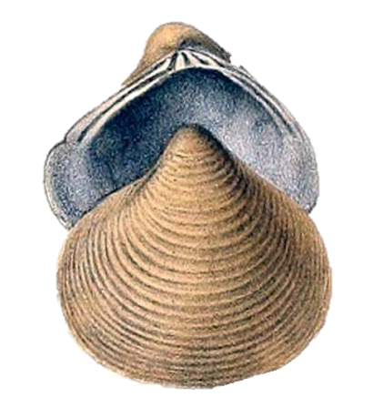
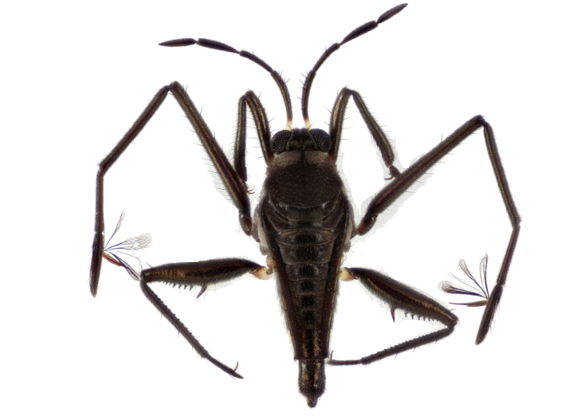
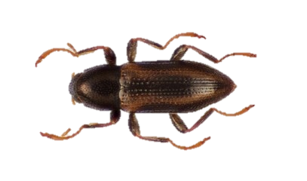
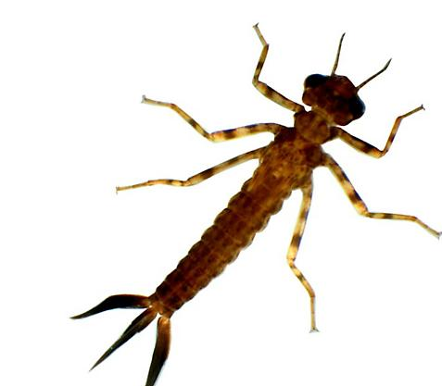
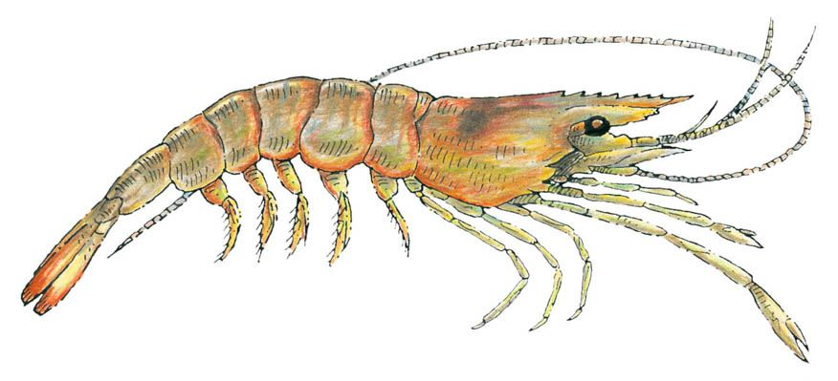
Low Flow %
Sipihlonurus
Biomphalaria
Fossaria
Campeloma
Amnicola
Pseudosuccinea
Bithynia
Melanoides
Scirtes | Belastoma
Brachycerus | Strobilops
Peltodytes | Ancyronyx
Ferrisia | Trepobates
Farrodes | Neoplea
Baetis | Physella
Leptohyphes | Fallceon
Plauditus | Rheumatobates
Caenis | Leptoceridae
Mesic
Sub-Humid
Semi-Arid
Relative
Humidity
Corbicula | Heliosoma
Stenelmis | Rhagovelia
Dubiraphia | Argia
Cyphon | Cheumatopsyche
Baetodes | Stactobiella
Stenonema | Palaemonetes
Conductivity
Notes:
Work Slide

Slide 6
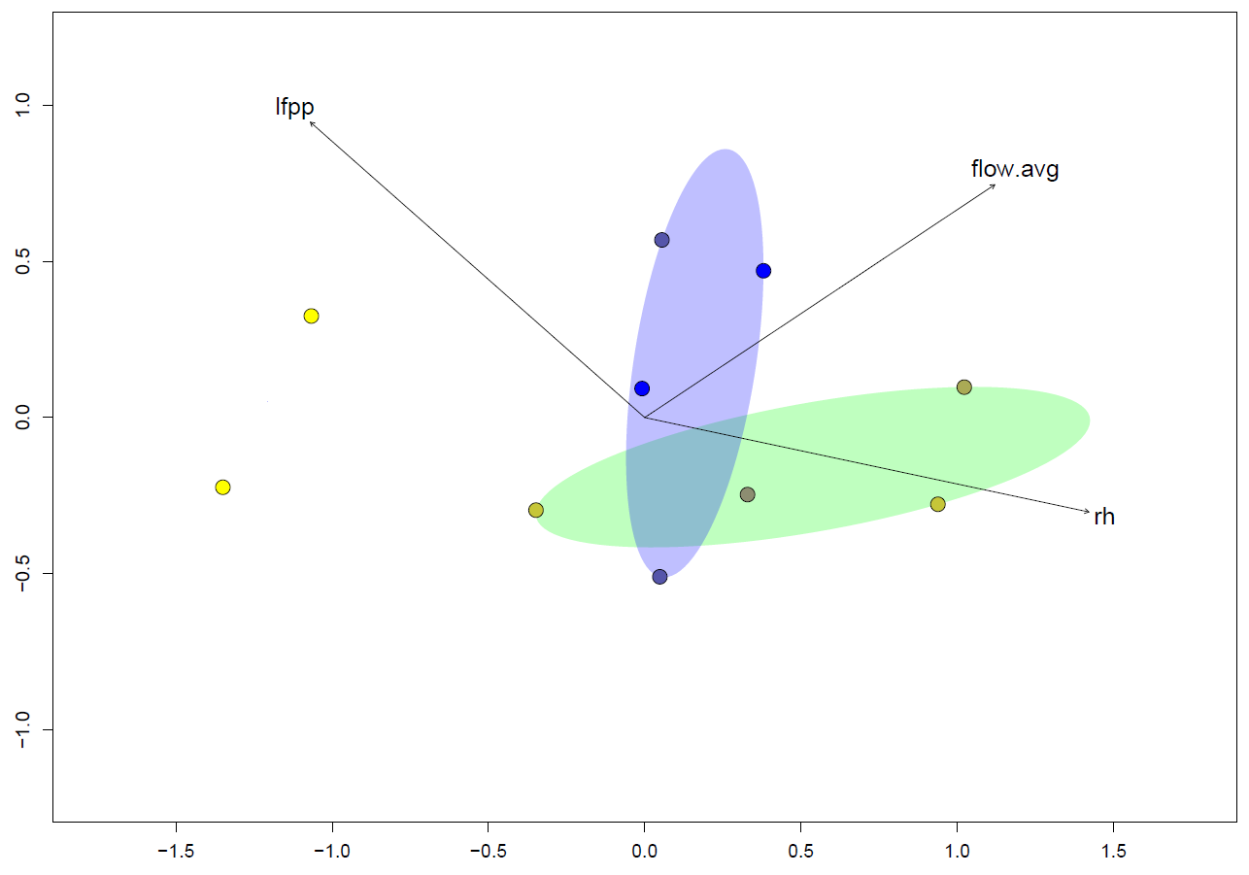
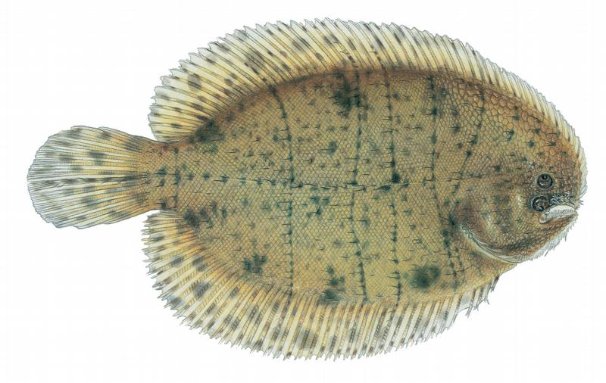
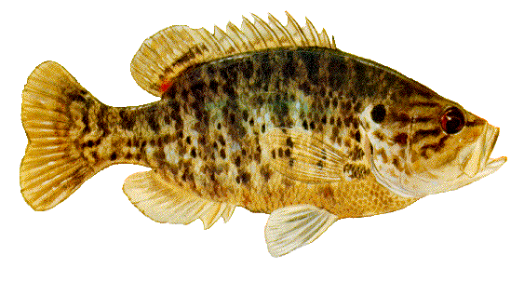
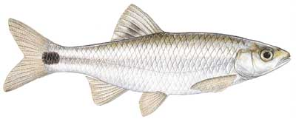
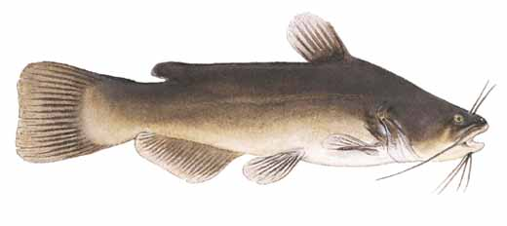
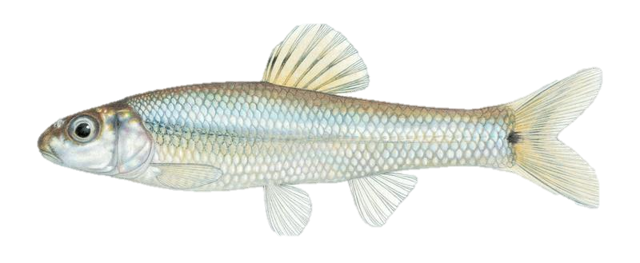
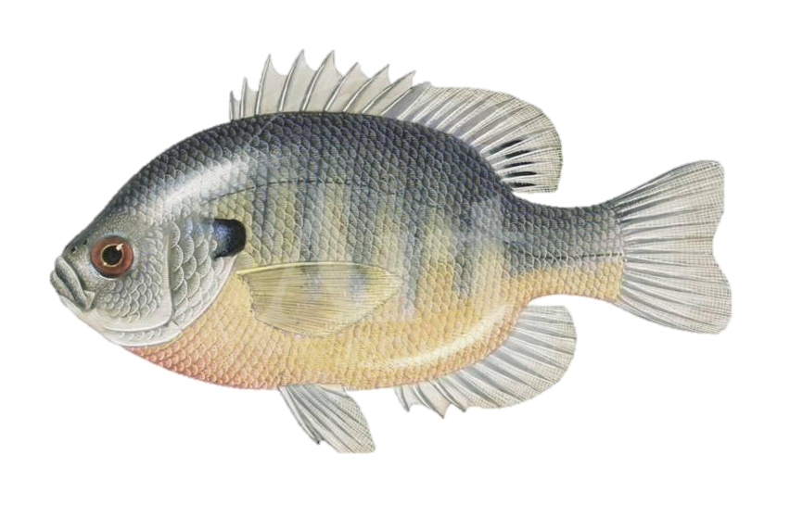
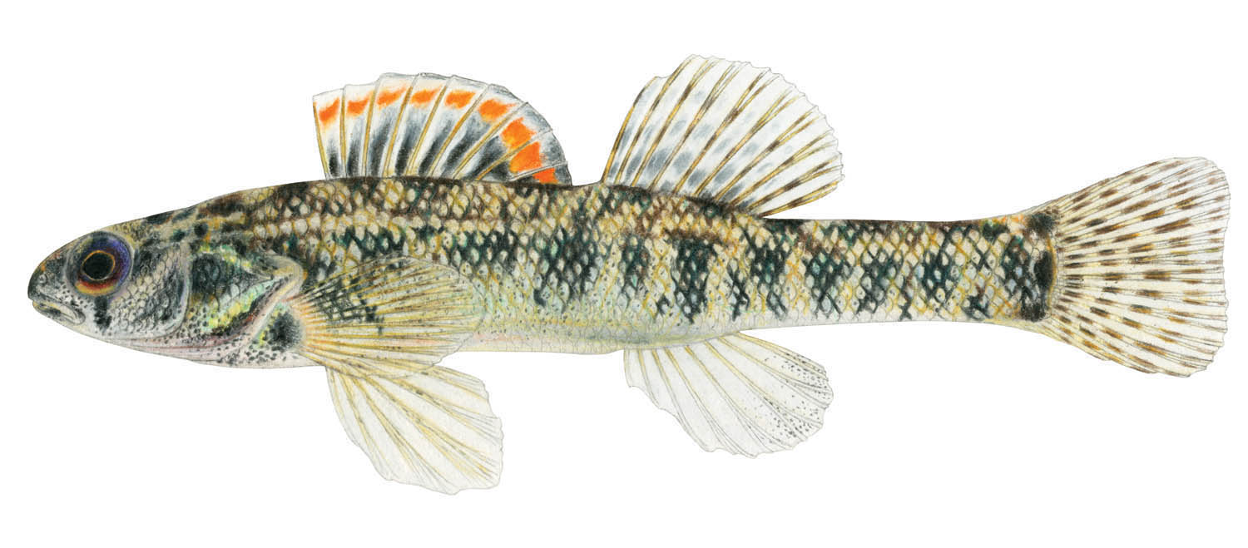
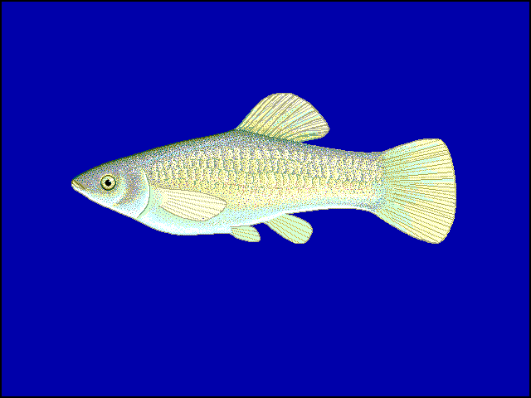
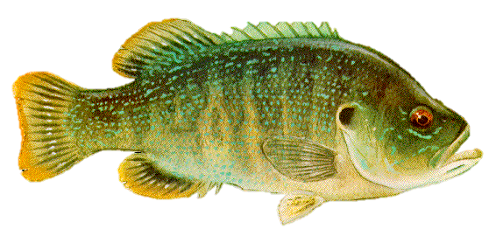
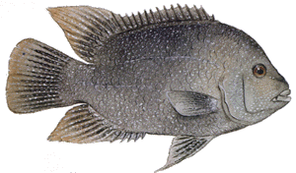
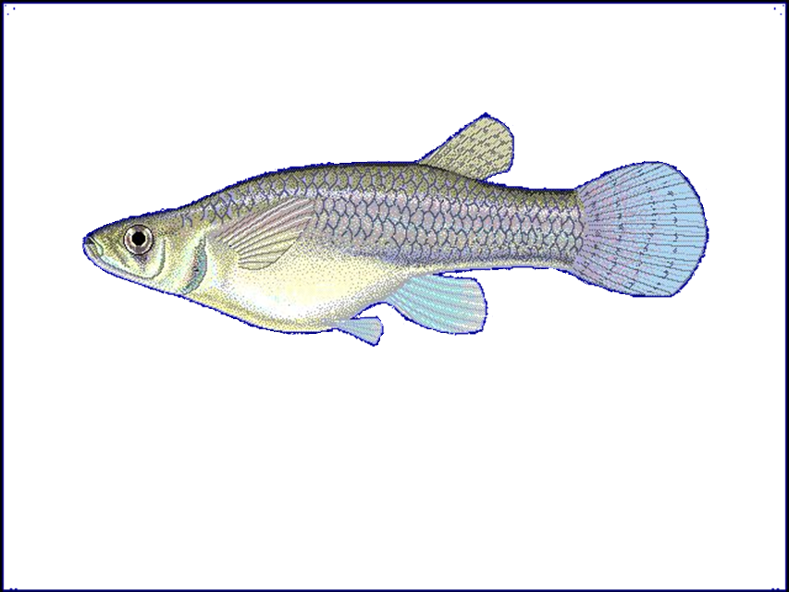
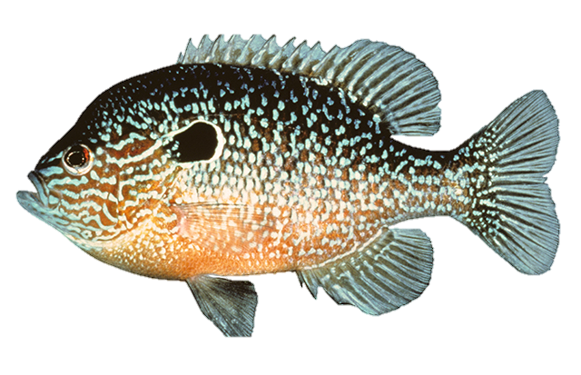
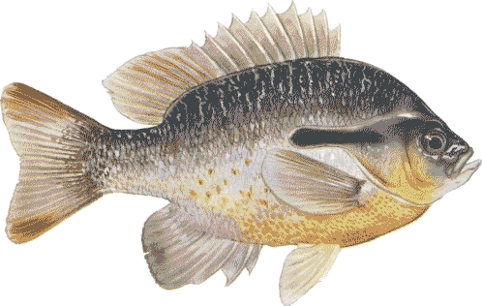
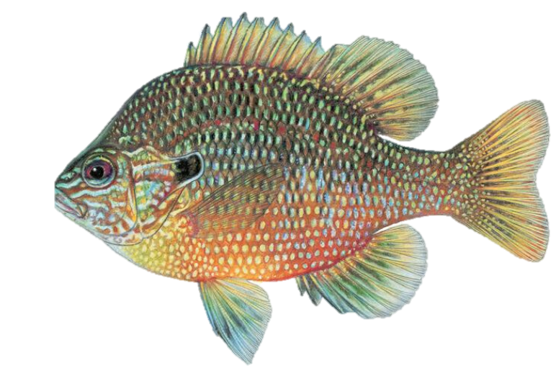
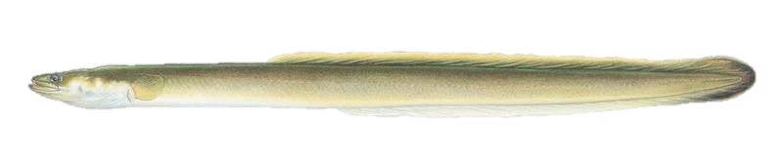
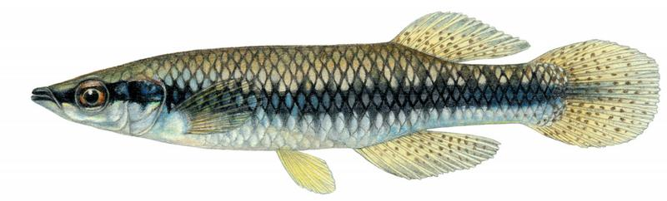
T. maculatus
C. venusta
L. gulosus
A. melas
Low Flow %
Mean Flow
Sub-Humid
Semi-Arid
Mesic
Relative
Humidity
P. vigilax
P. latipinna
G. affinis
E. gracile
H. Cyanoguttatus
L. auritis
A. rostrata
L. macrochirus
L. cyanellus
L. megalotis
L. marginatus
F. notatus
Notes:
Work Slide

